Slide 1

EventOws
Event and Shows Application

Slide 2
Contents/Index
What is EventOws?
Application Architecture
Database Design and Implementation
Functionalities of the Application
Future of the Application

Slide 3
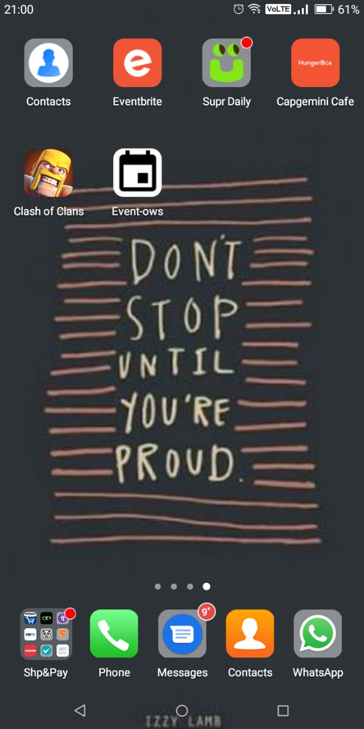
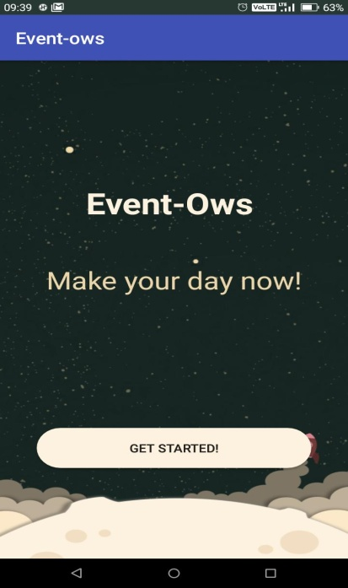
What is EventOws?
EventOws basically means Events and Shows.
The objective of this app is basically to show the smallest events and shows available in your locality.
In this App, we define Event as a small 2 to 3 hours occasion,
which can be mostly private .
Whereas, we define Show as a large 7 to 8 hours occasion, which is mostly public.

Slide 4
Application Architecture
Register
Username and Password
Events
Shows
Your Added Events
Your Added Shows
Register your Full Name Password and your age for your user profile.
Login Process After verification from your registered email to app main page.
Events registered in the database are now displayed here including the title, location, date, time.
Shows registered in the database are now displayed here including the title, location, date, time.
When you want to add an event, you fill the details and click on add button which will add your event in Events Section and display it under My events where you can edit that Event.
When you want to add a show, you fill the details and click on add button which will add your event in Events Section and display it under My events where you can edit that Event.
Firebase

Slide 5
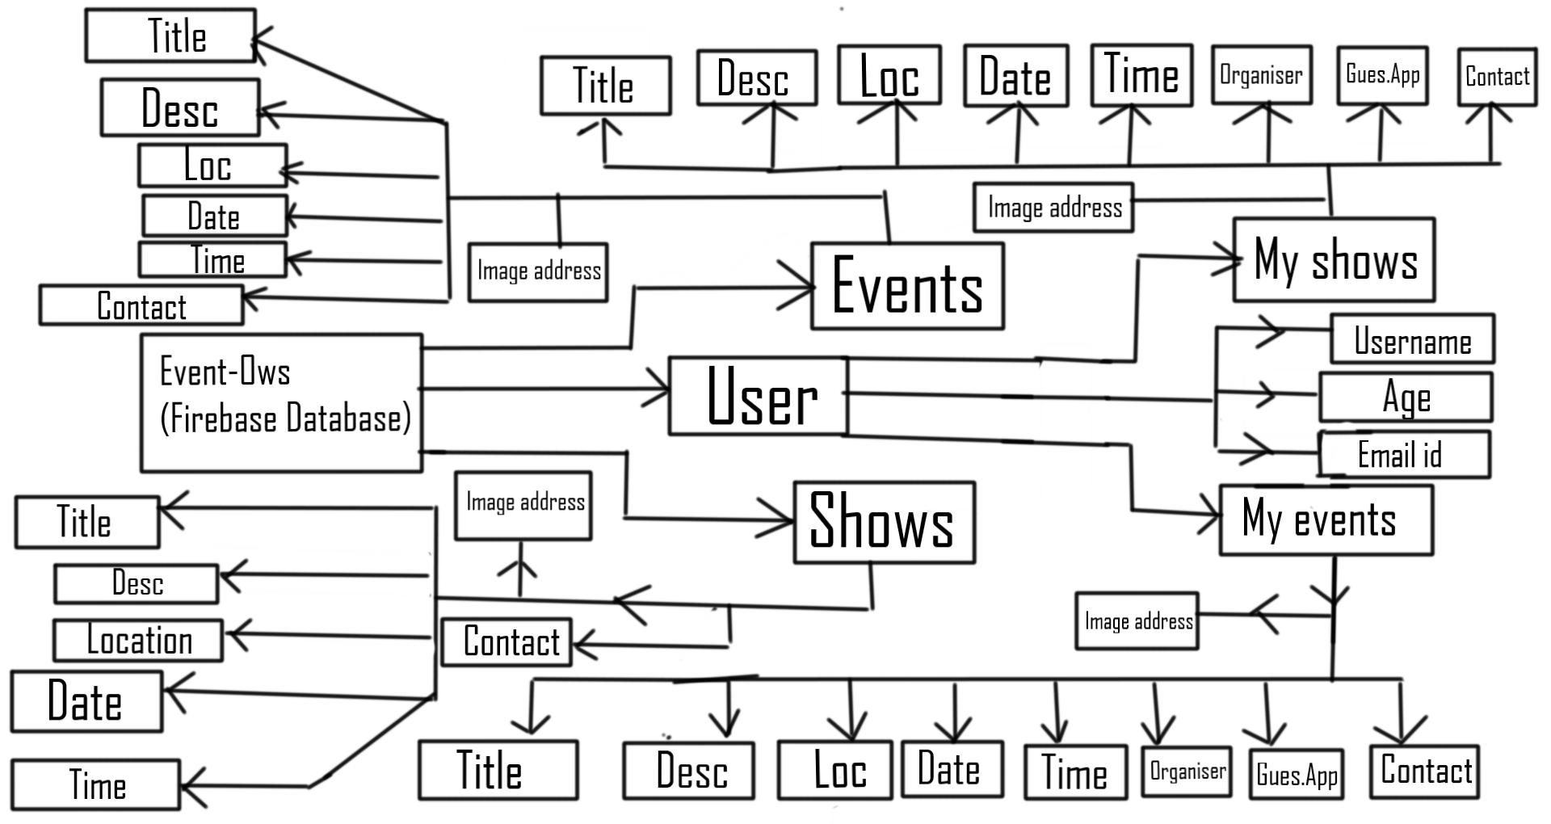

Database Design

Slide 6
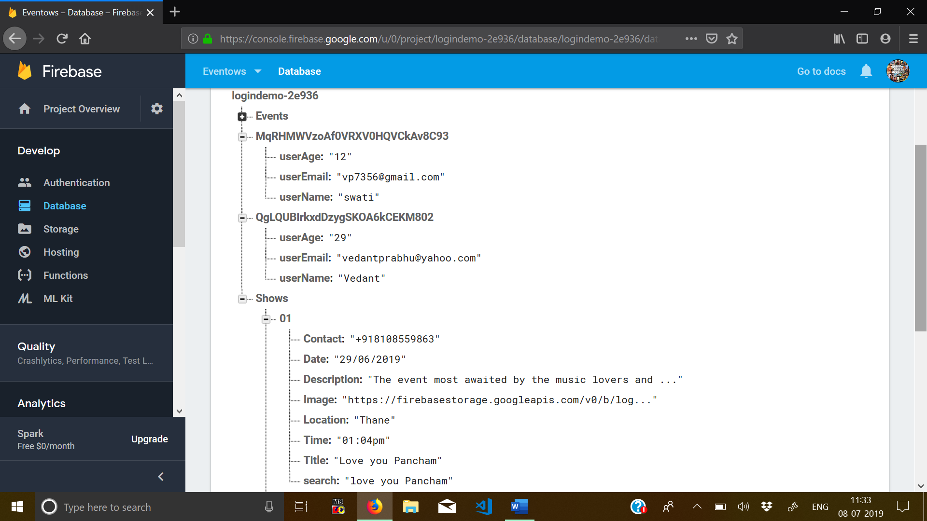
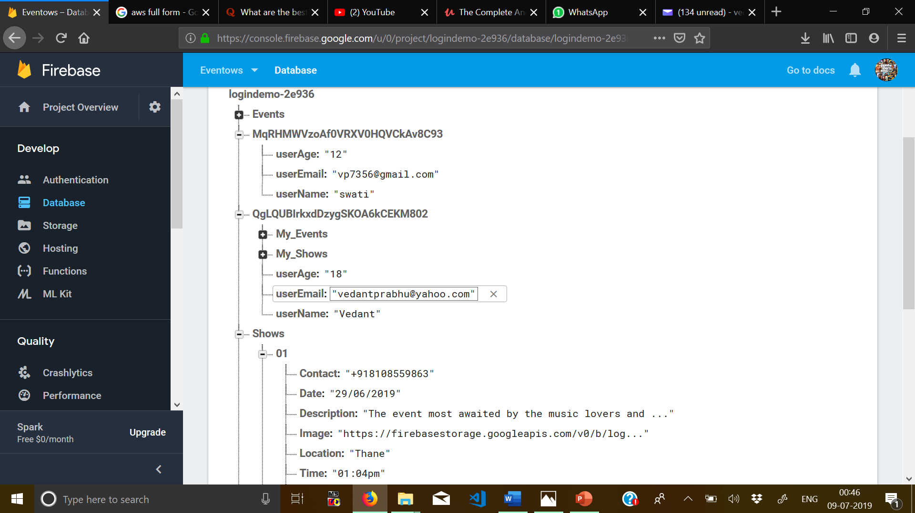
Firebase Database Design for EventOws

Slide 7
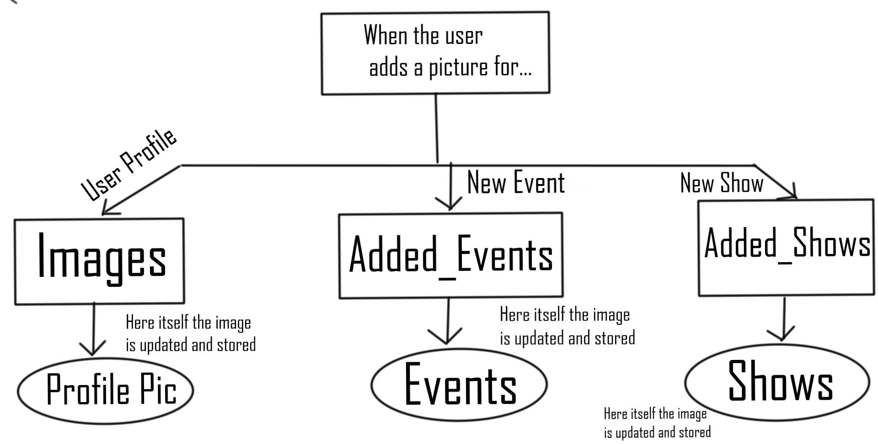

Firebase Storage Design for EventOws

Slide 8
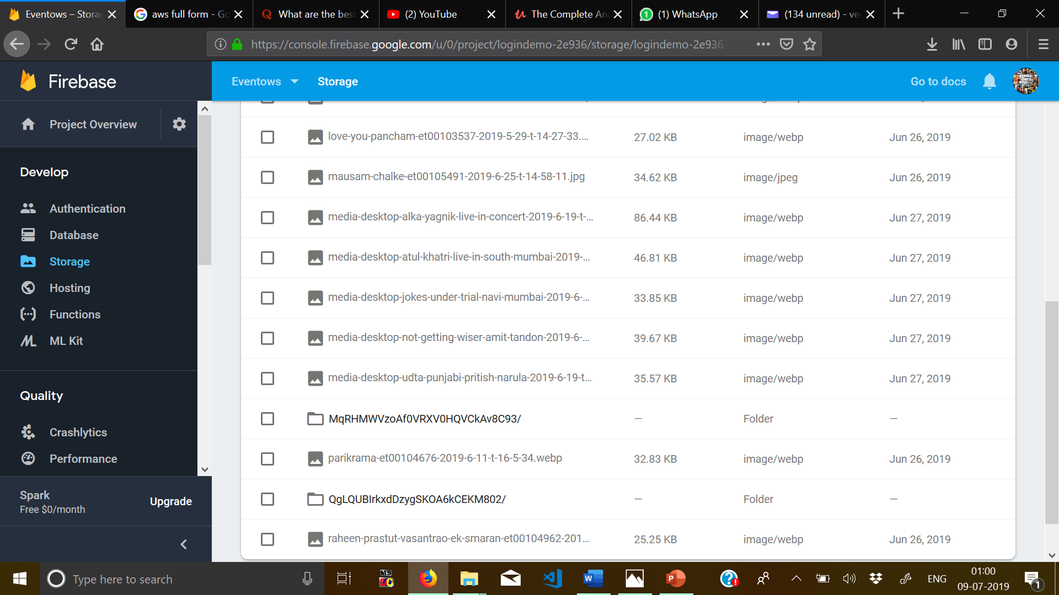
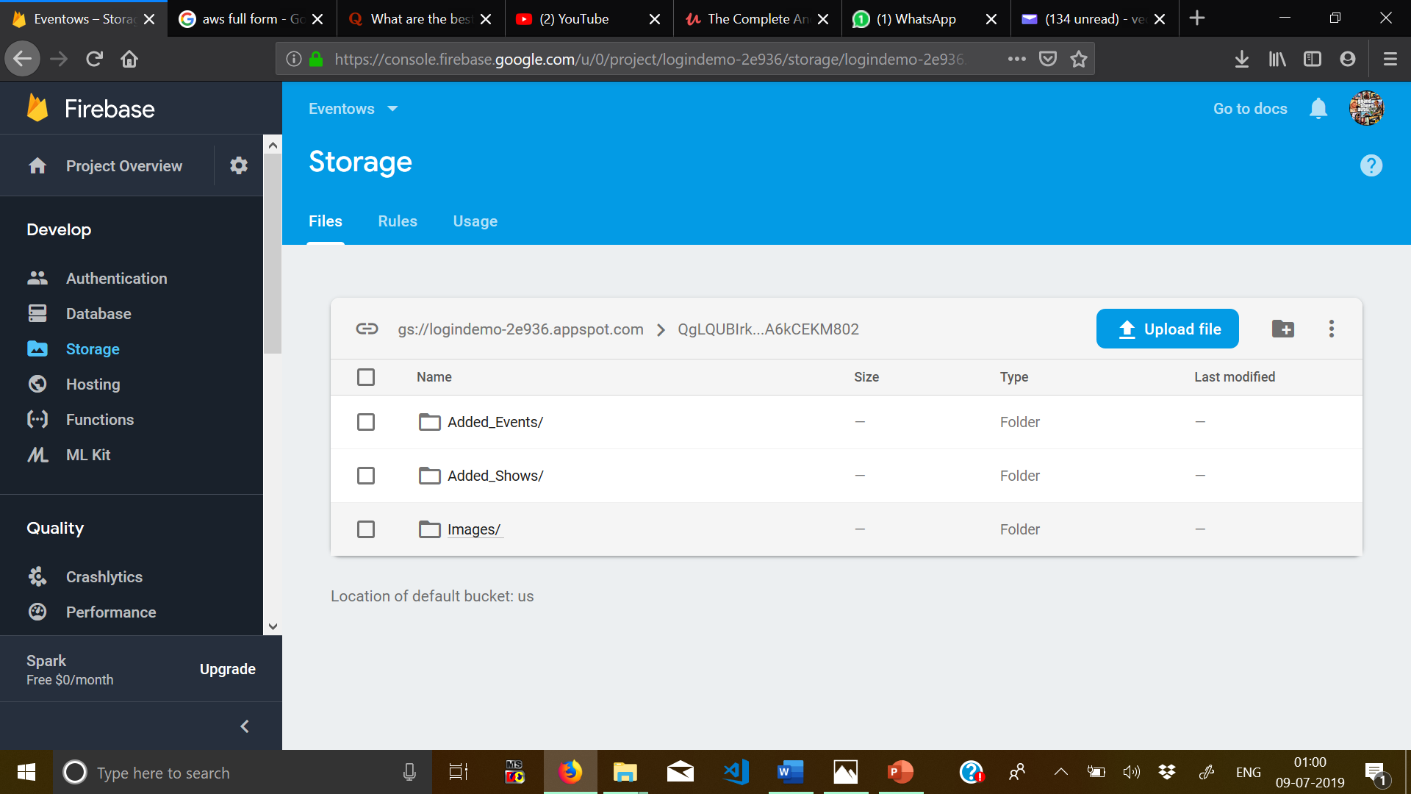
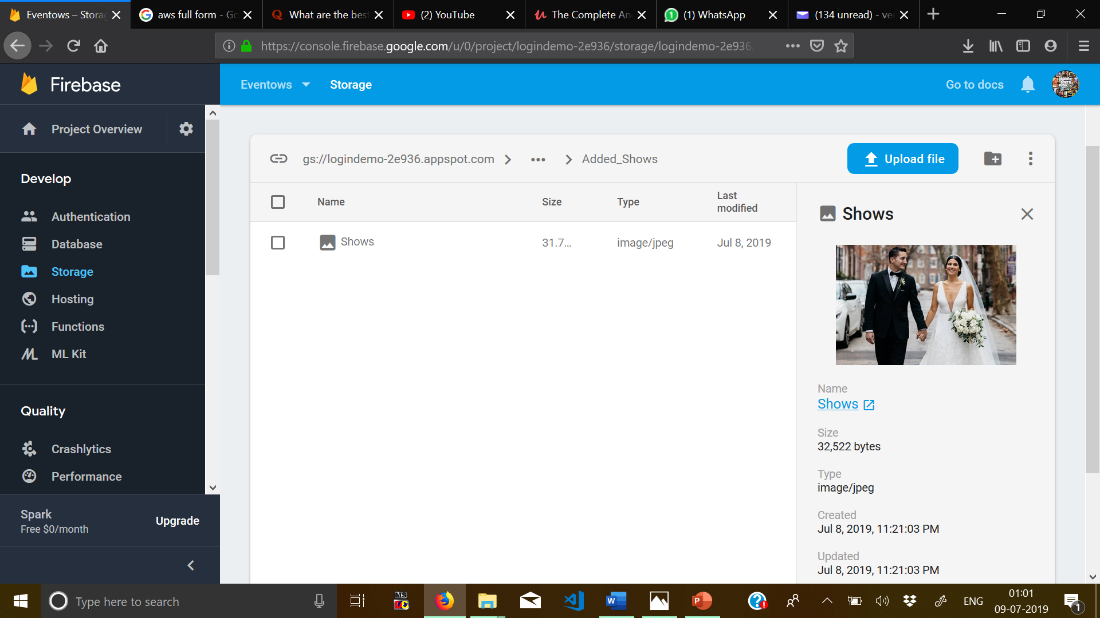

Slide 9
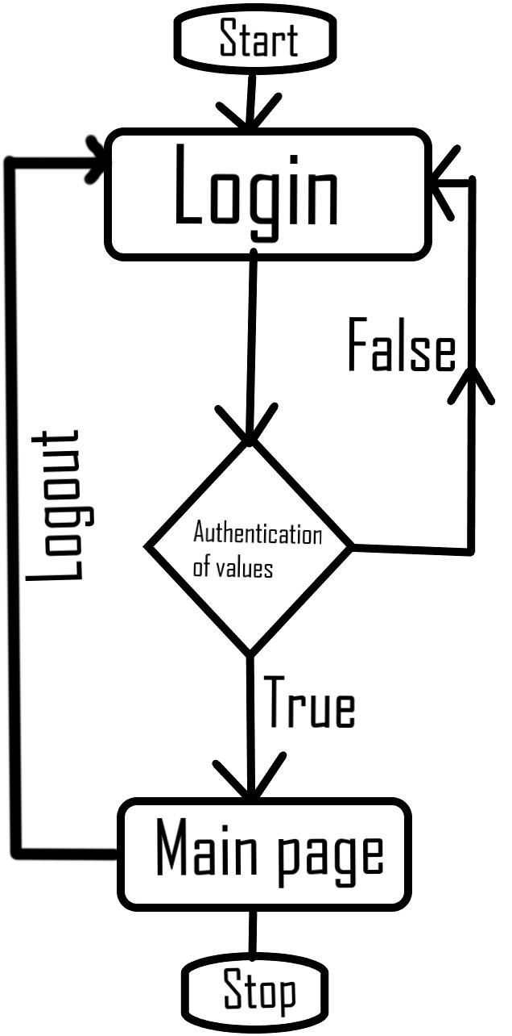

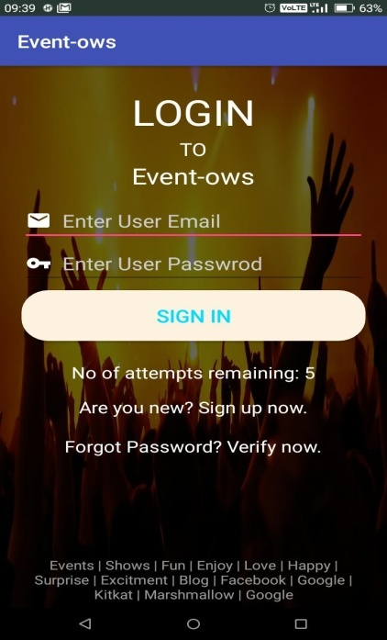
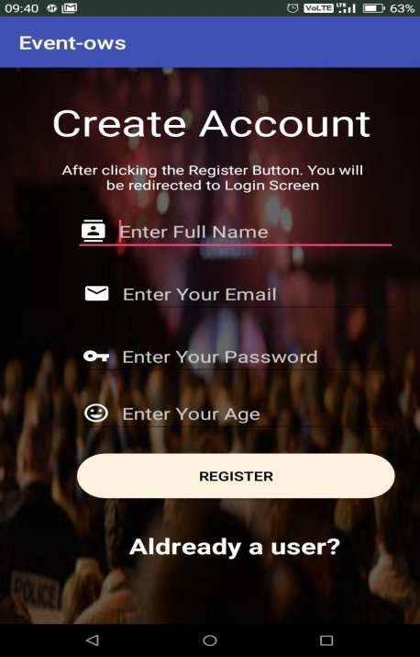
Login Authentication and Registration
Starting from Register, A new register always register himself in the app by putting his: -
Name used for User Profile
Valid Email for Verification and Authentication (Also for User Profile)
A Password for Verification and Security
Age for User Profile.
After successful Registration he is reverted to the Login Page where he has to verify himself and this is done by Firebase Authentication.
Firebase sends an email verification link to the email id which the user had registered during Registration. This needs to be verified otherwise your account is not activated and you are not permitted to login.
After successful verification and correct password, you are signed in.

Slide 10
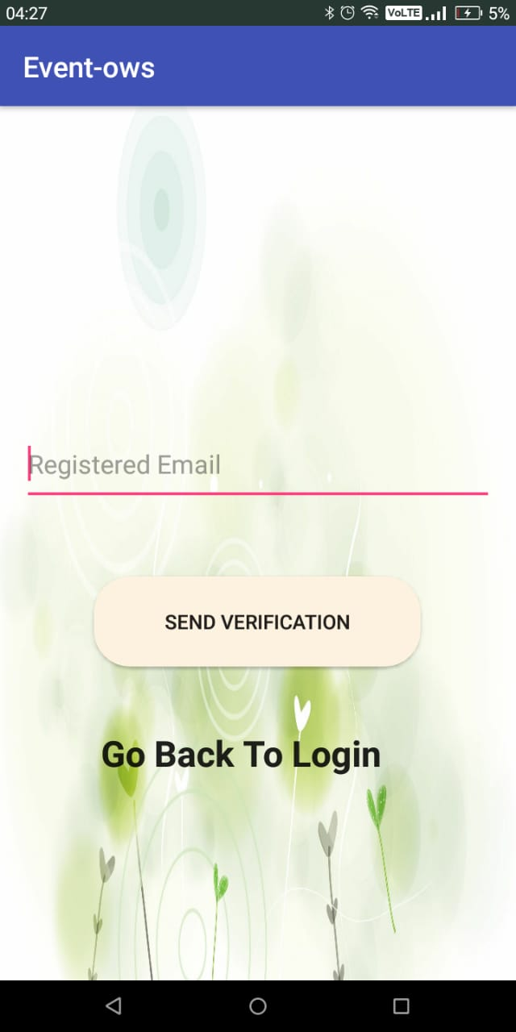
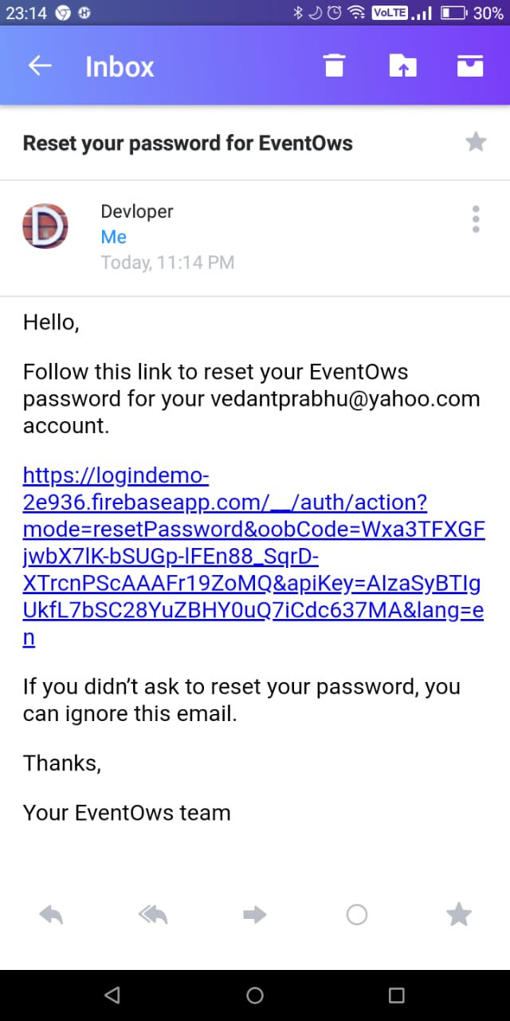
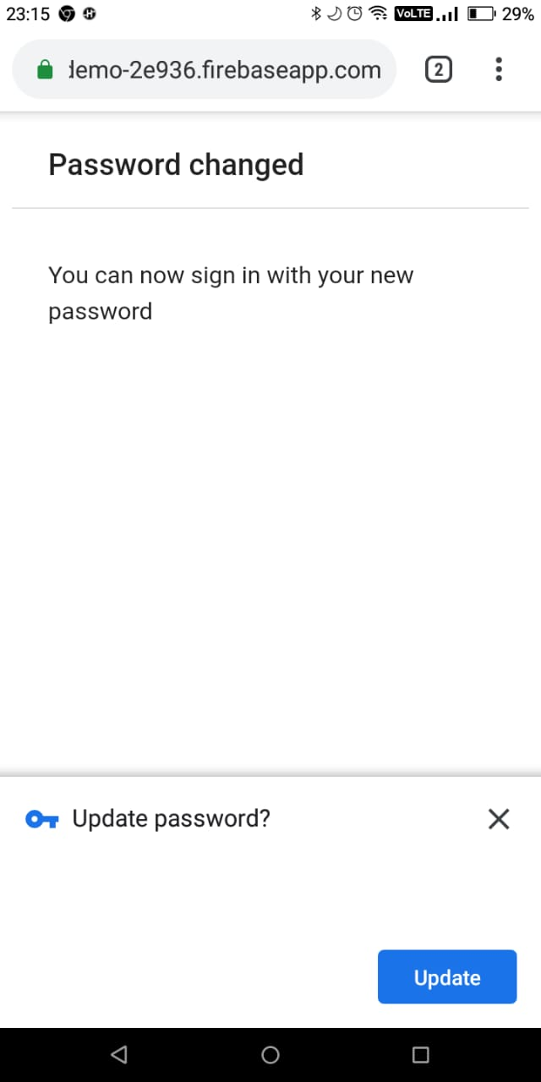
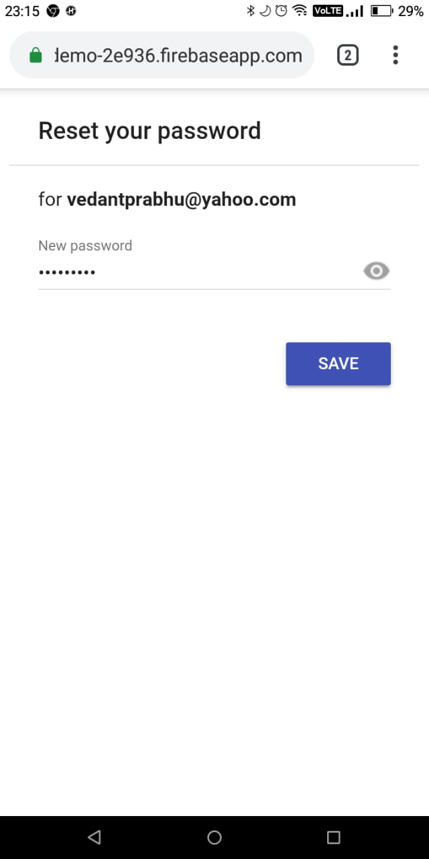
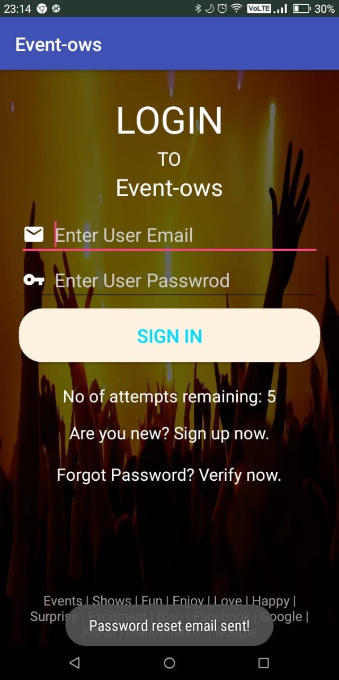
Forgot Password
The forgot password feature helps you to change and keep the new password in case you forget the password. For this you need to be a registered user and enter the registered email id.
A password reset mail will be sent to your email id which on clicking, you set the new password, and you can successfully login your account.

Slide 11
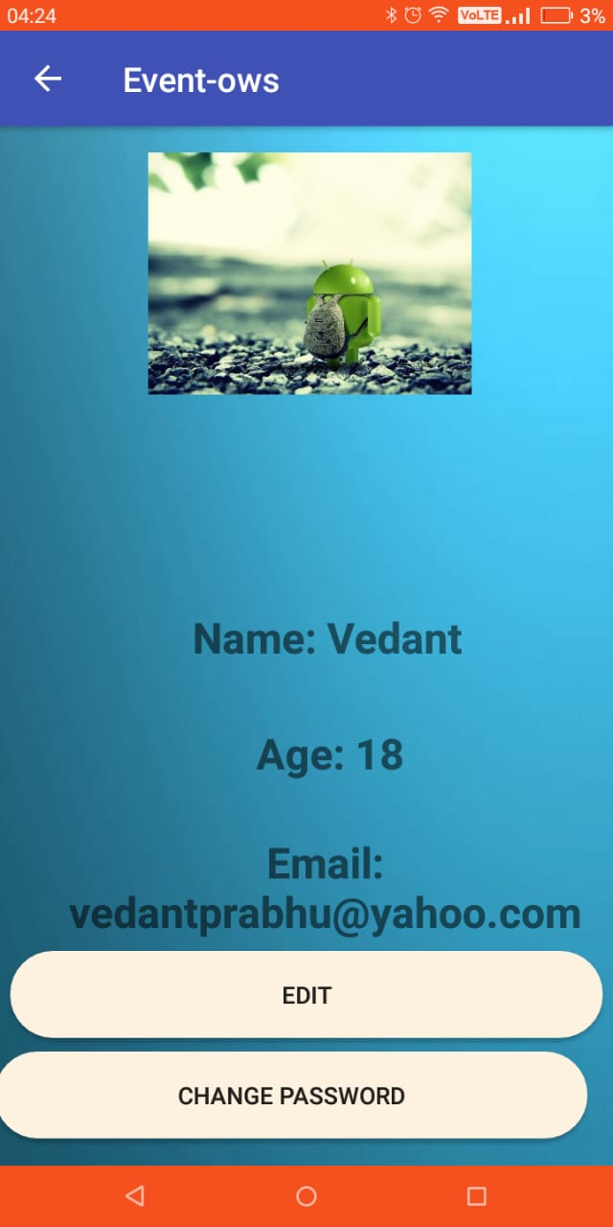
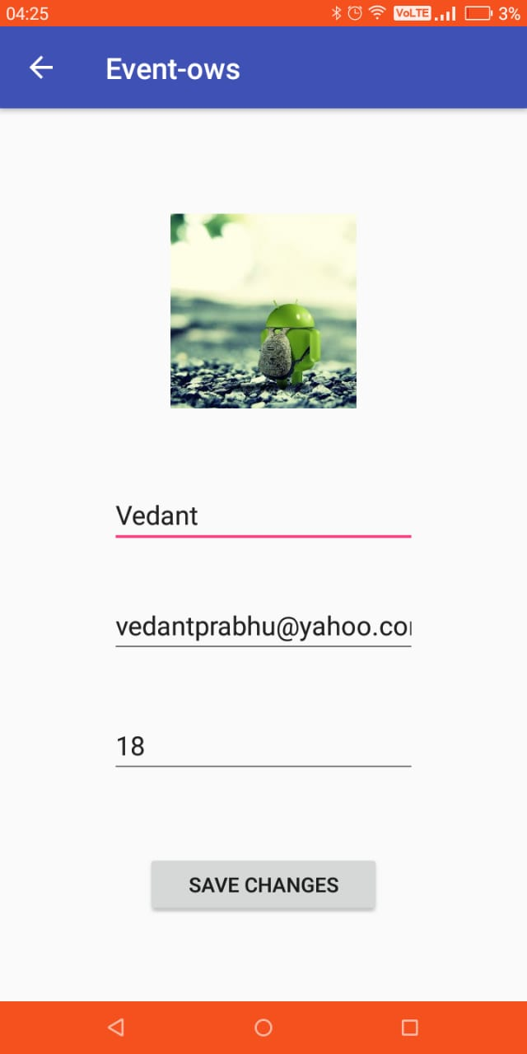
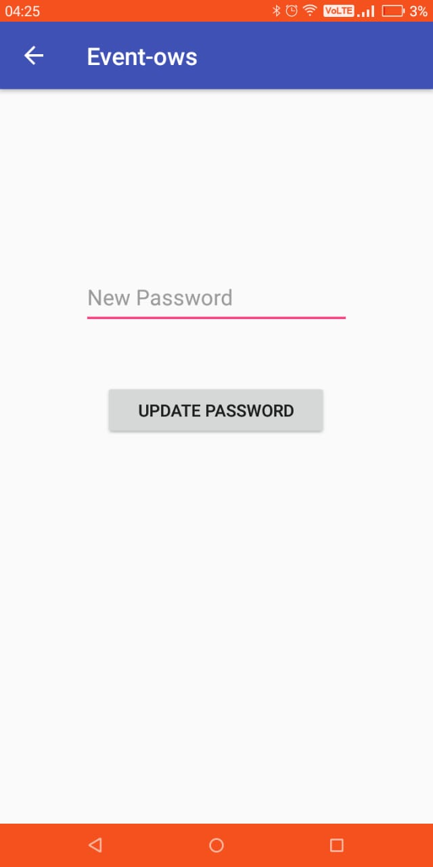
Profile Activity
For user Profile, the Firebase reads the data of the user from Real-time Database which displays: -
Name- Entered during Registration.
Age-Entered during Registration.
Email- Id Entered during Registration.
On clicking edit profile, you can edit the above preferences and on Saving the changes get updated.
On clicking change password, you can change and set and keep a new password.
Now when you add yourself a new Profile Picture on the application it works as following: -
The picture you add is stored in the Firebase Real-time Storage where your user UID is created.
Under this User UID, inside the Images folder your profile picture will be updated as per you change your profile picture. It is done to avoid Confusion.

Slide 12
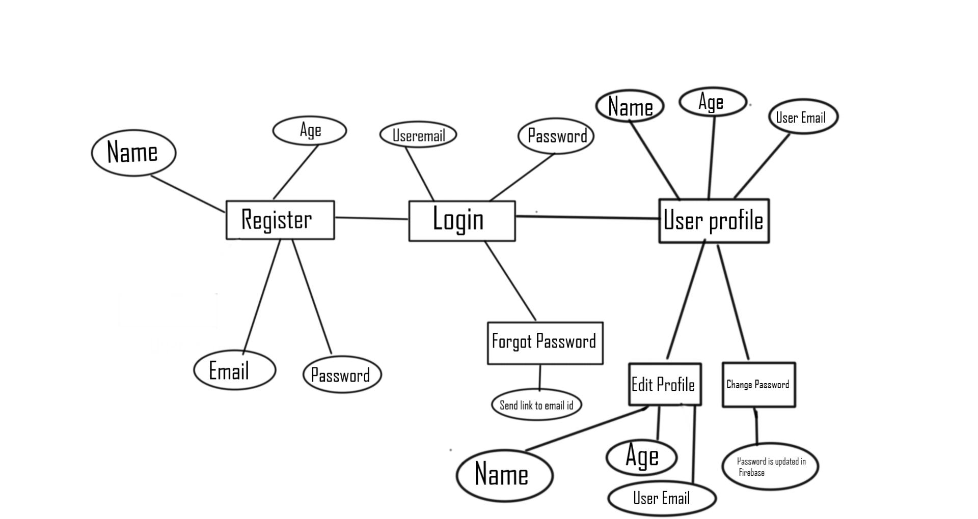
Simple Diagram Representing Login, Registration and User Profile

Slide 13
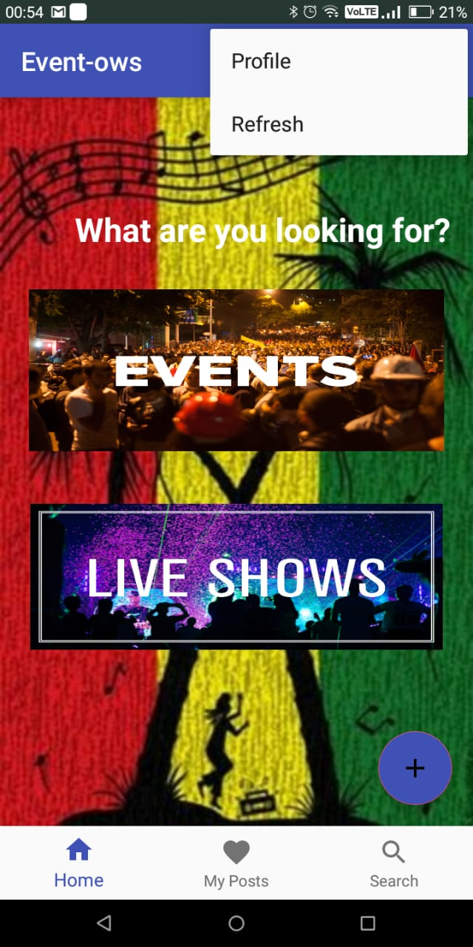
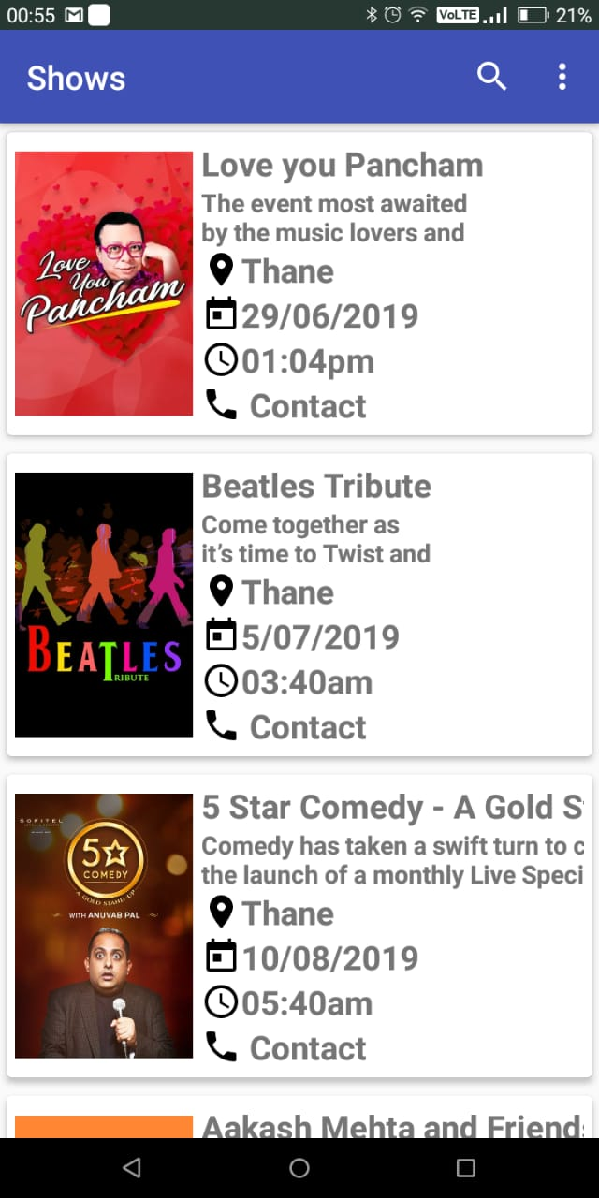
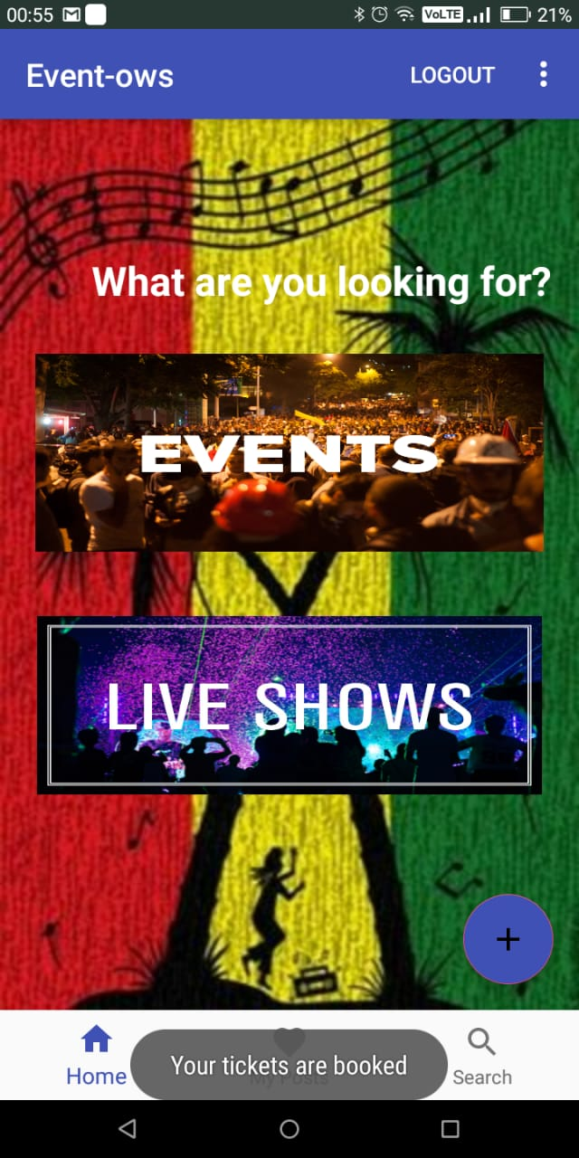
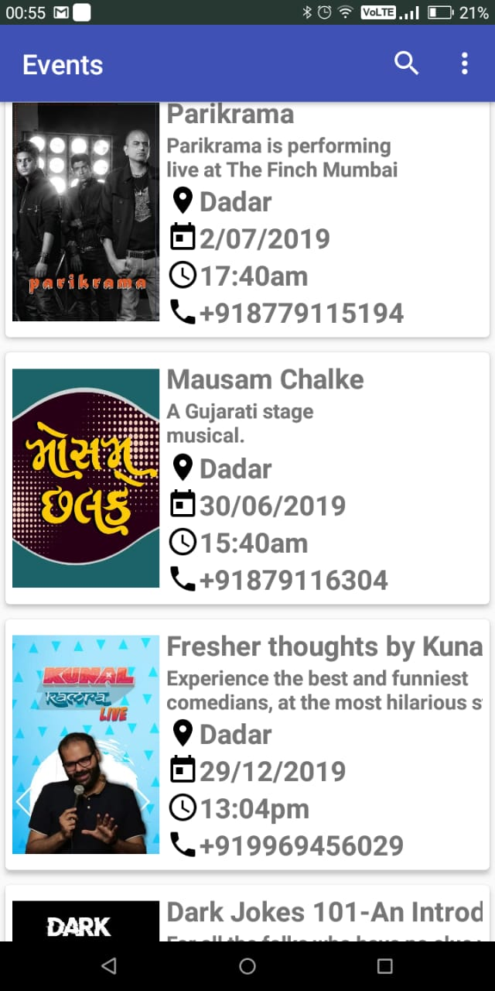
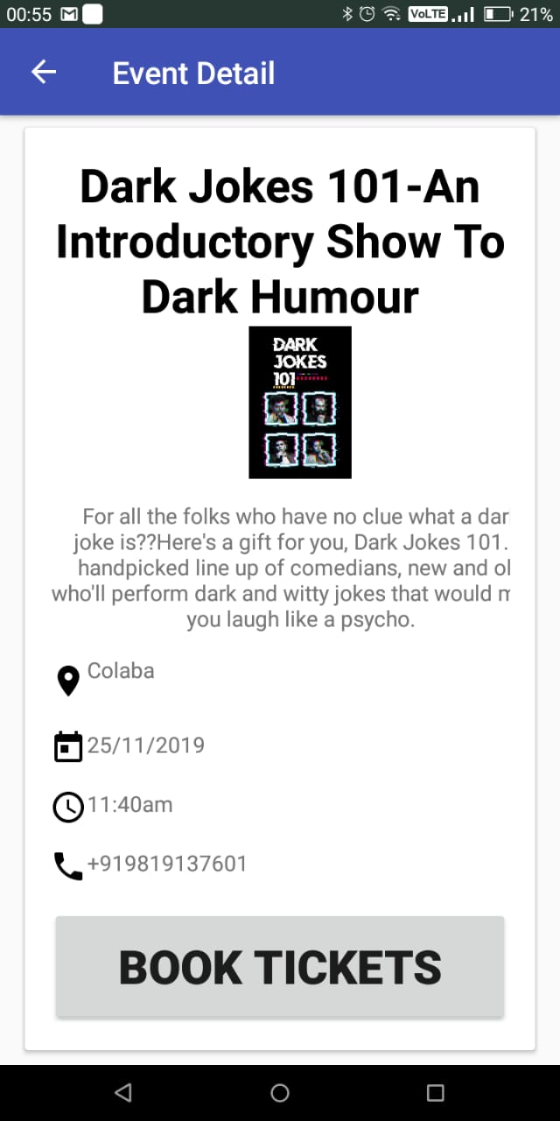
Viewing Events and Shows
In this project, Displaying of shows and events can be displayed with proper sort view from newest to oldest or from oldest to newest, with an added search bar to search the event .
Also when you click on the Event card/Show card , Proper details of the event/shows are seen
When you click on book tickets, Tickets are booked for that event.

Slide 14
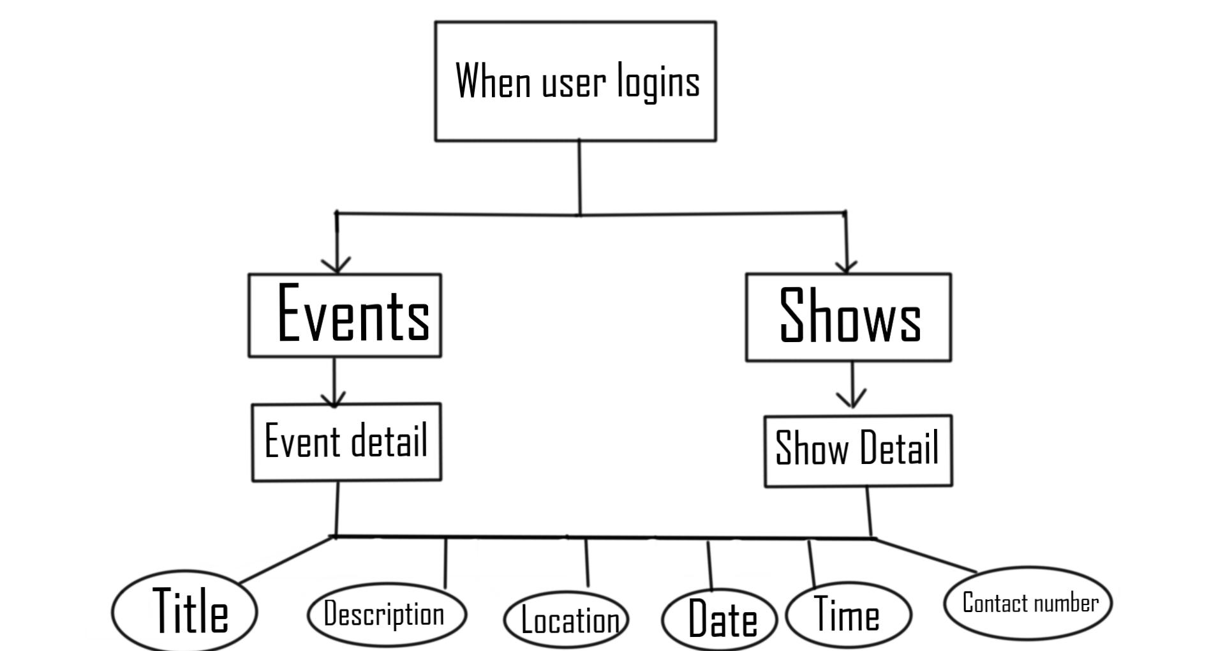
Simple Diagram Representing Events and Shows

Slide 15
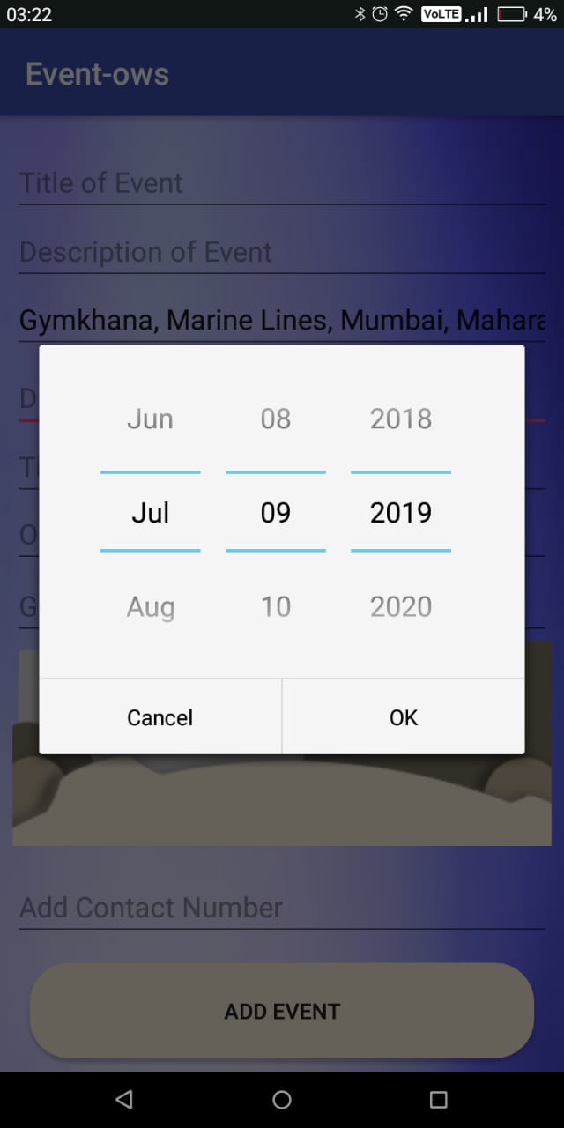
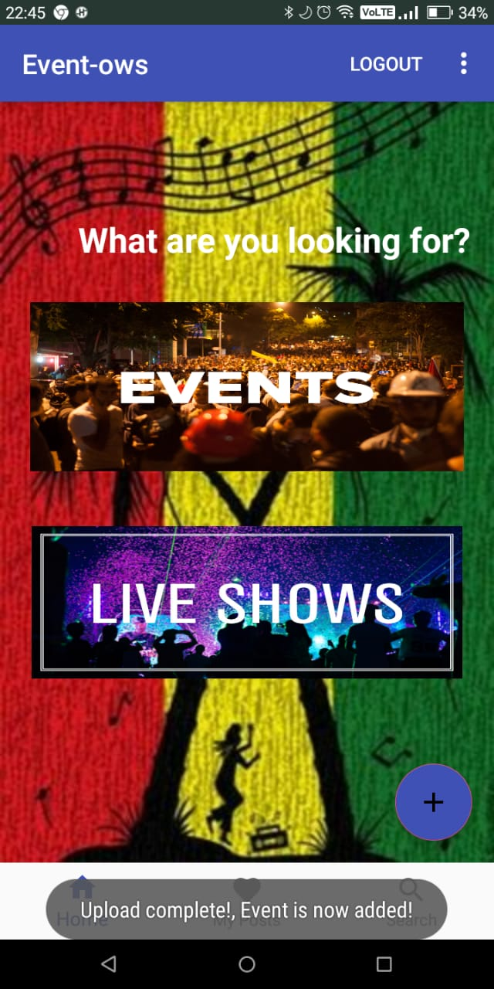
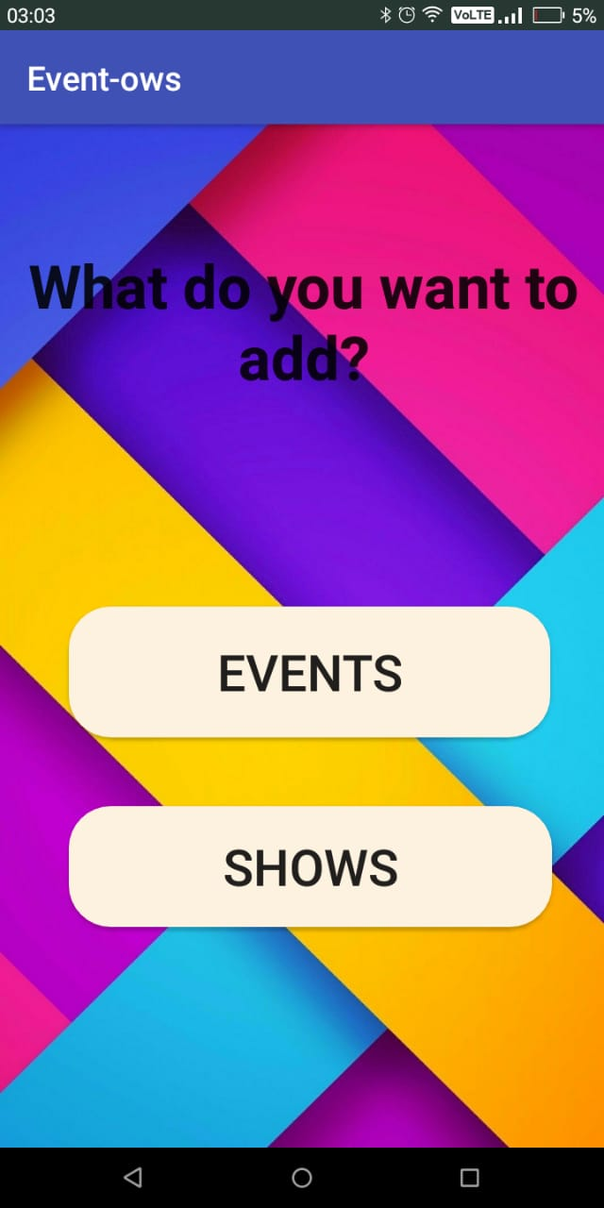
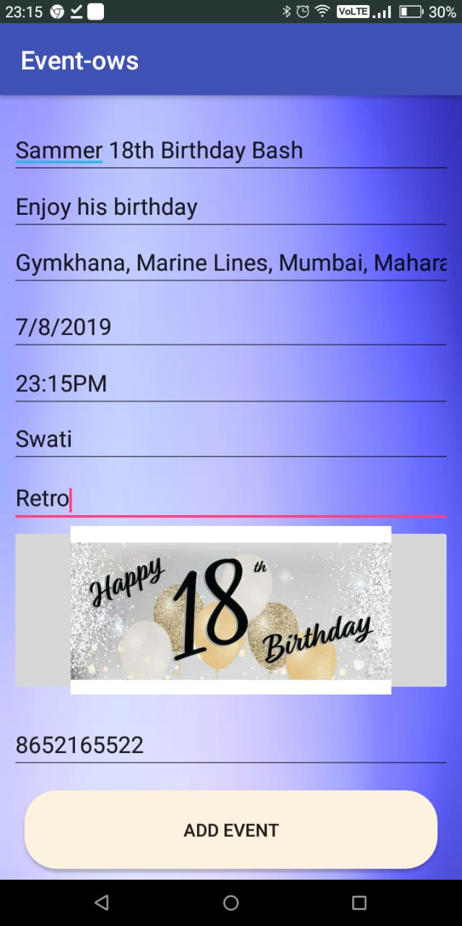
Adding your own Event/Show
In this app, you can also add you own event and show and view it in My events and My shows
Basically when you, register the event, the event is stored in the User UID, so for that particular user, It will view the event from the firebase.
You can only add one Event at a time, which can be edited and updated by its name as well as Picture of the event.

Slide 16
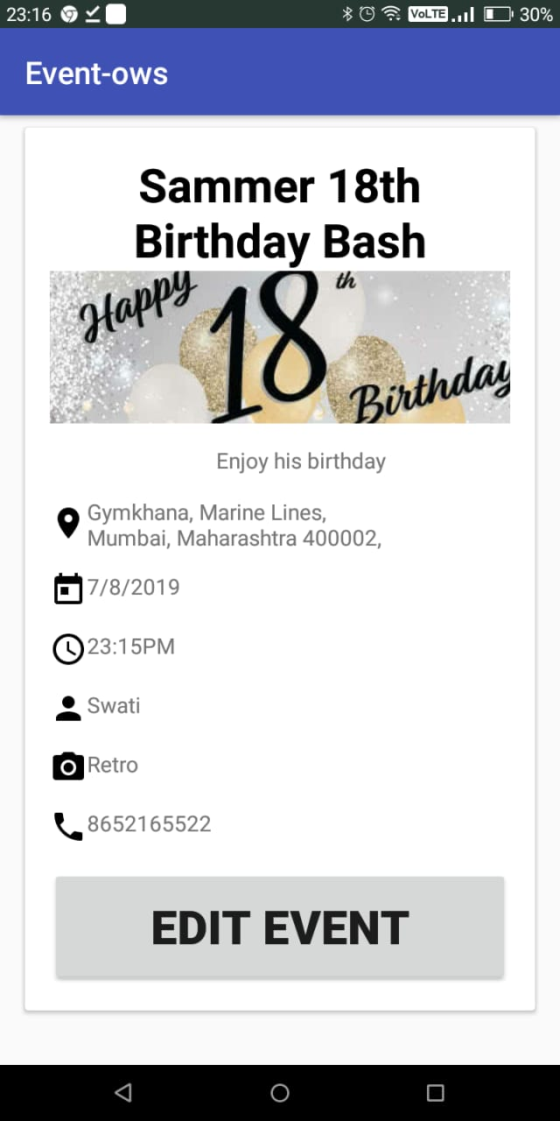
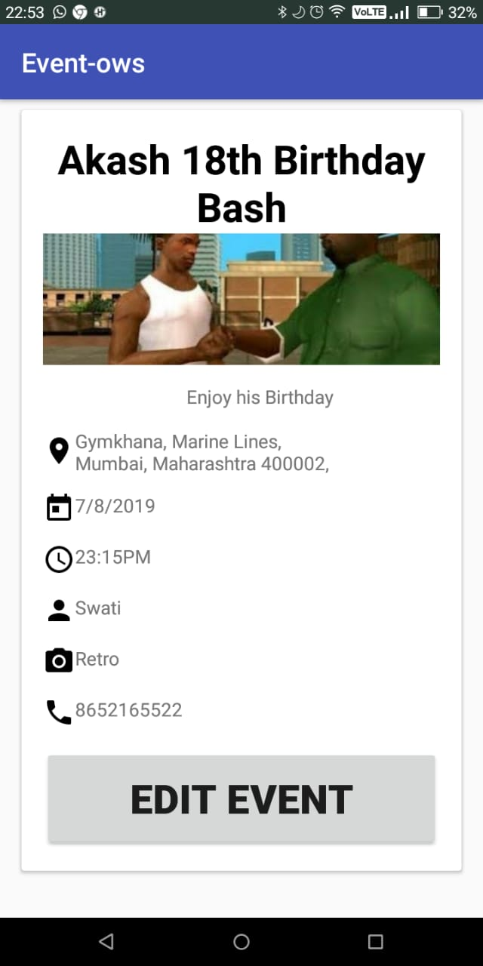
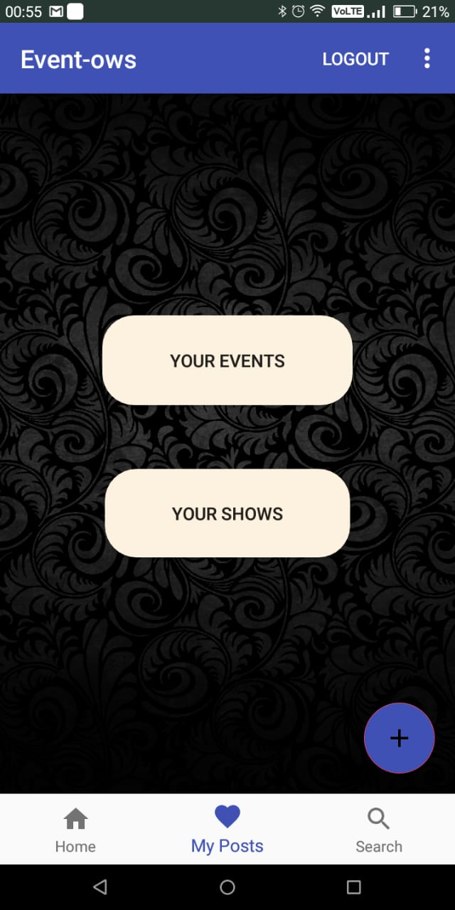
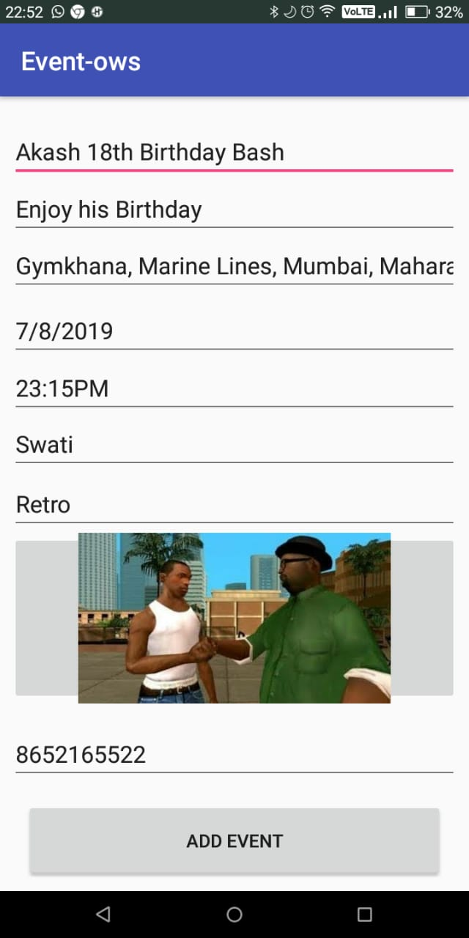
Viewing your Event/Show
In this app, you can also add you own event and show and view it in My events and My shows
Basically when you, register the event, the event is stored in the User UID, so for that particular user, It will view the event from the firebase.
You can only add one Event at a time, which can be edited and updated by its name as well as Picture of the event.

Slide 17
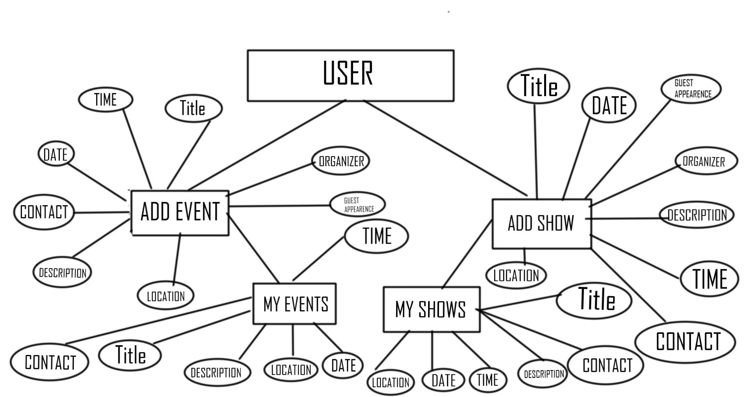
Simple Diagram Representing Creation and Viewing your Events/Shows

Slide 18
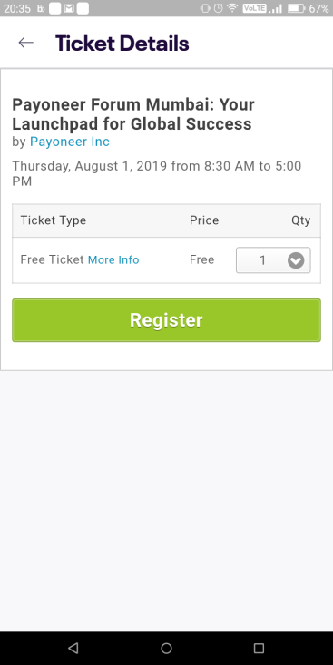
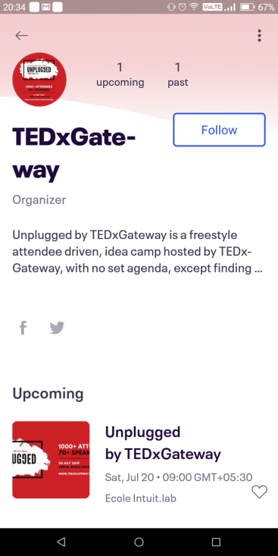
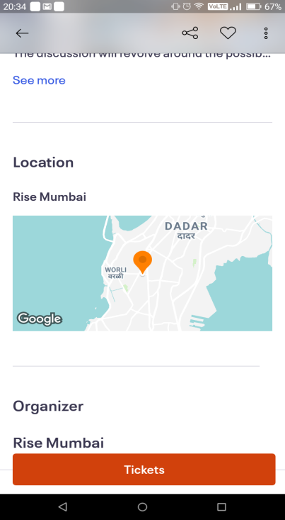
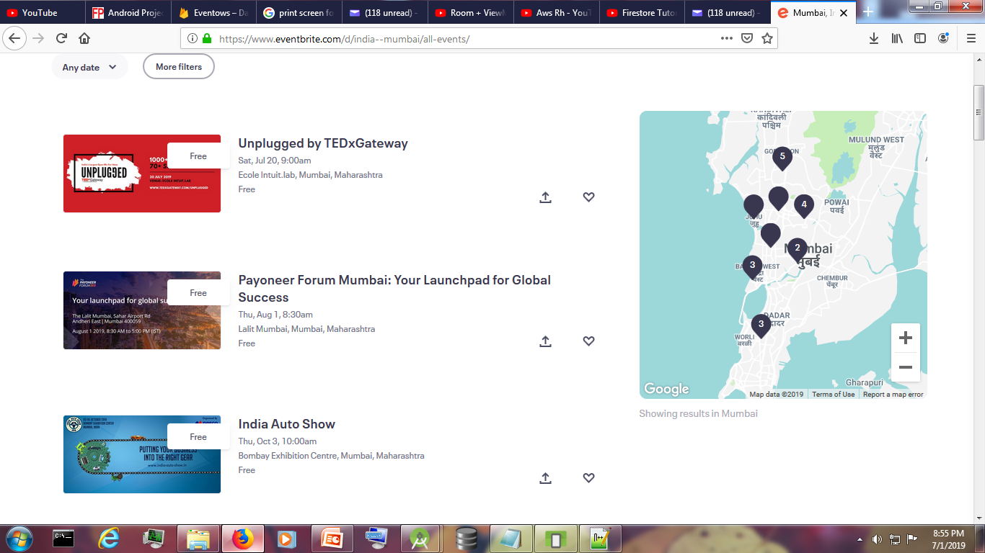
Road Map of the Application
In this app more upgrades that can be introduced are:-
More interactive User-Interface to be implemented in future.
Adding the Maps API and tracking features to enable identifying locations more precisely.
Adding Comments and Reviews to every particular Event or Show to look it more social and attractive.
Website shall soon be developed.
Payment Integration(Brain-Tree) shall be implemented for fast and safe checkout.

